Slide 1
Team: Doesn’t Exist

Slide 2
PROBLEM STATEMENT
Human-caused (anthropogenic) greenhouse gas emissions and natural systems that produce and absorb greenhouse gases (sources and sinks) interplay in a complicated manner to contribute to global climate change.
As policymakers and citizens race to combat climate change, understanding this interplay is more important than ever.
Your challenge is to use a combination of satellite and model-based datasets to map both human-caused and natural greenhouse gas emissions to enable better understanding of how these emissions contribute to a warmer world.

Slide 3
OBJECTIVES
Create a map: Visualize these emissions so it's easy to see where they’re concentrated, notify people about various changes in GHG from past over the years.
Alert System for higher plumes activity and Gui (Tkinter)
Monitor big events: Track things like methane leaks or large CO₂ releases.
Offer solutions: Suggest ways to reduce emissions and protect natural systems like forests that absorb CO₂.
Create Interactive Mapping for easy Understanding

Slide 4
THINGS TO IMPLEMENT
Interactive Earth Globe : for dynamic representation of globe and their Ghg Emissions.
GHG Emissions per Capita: Average GHG emissions at different countries
Plumes Alert system: to notify people through alert system that he or she is in high plume region, to alert them to stay away from that area
GUI: Creating a graphical user interface where the user can get data of a country by simply writing name of the country and global warming and weather would be displayed.
Chat-Bot AI: for queries related to global warming
Q-GIS For Mapping Tool: Mapping tool used for mapping satellite images, and get specifications GHG changes all over this years.
App Development: for offline device as an total information and dynamic structure to understand GHG emission and prevention.
Data Analysis using Power-Bi: create dynamic analysis with accurate results.

Slide 5
Technologies Used
Html, CSS, Javascript, Flask – Creating Webpages
Python- Alert System, Gui, Backend Integration
Flask- Backend Integration
QGIS- Mapping Tool
Android Development using JetPack Compose- App development
Power Bi for Data Analysis

Slide 6
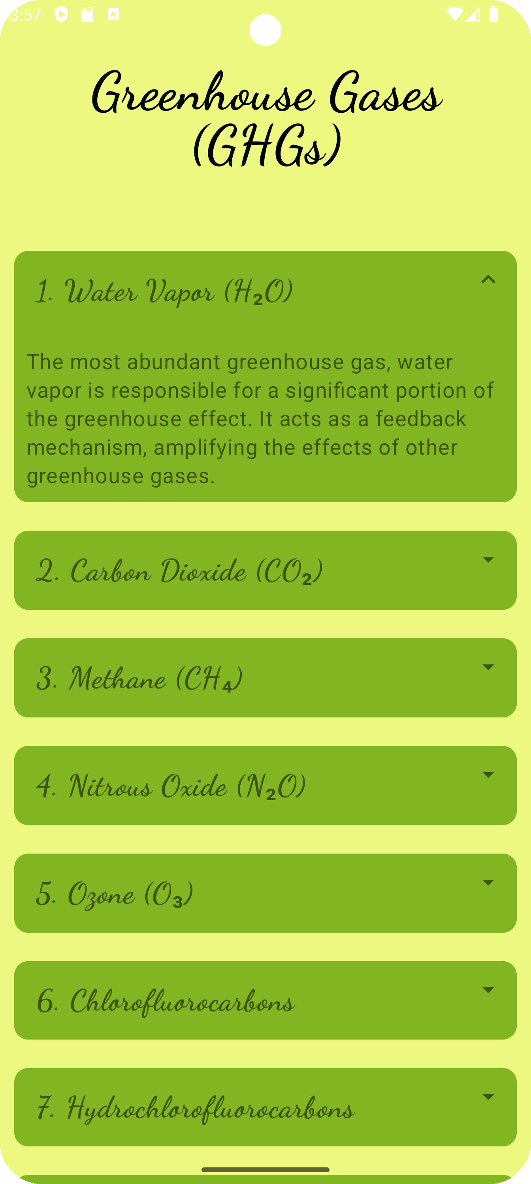
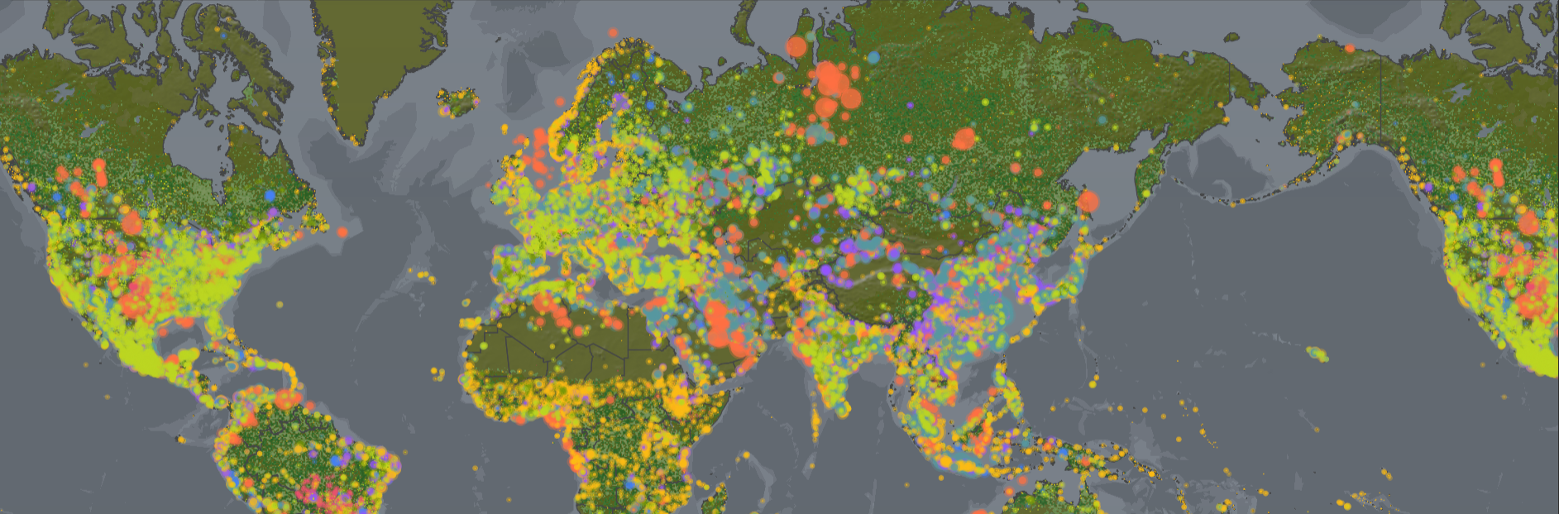
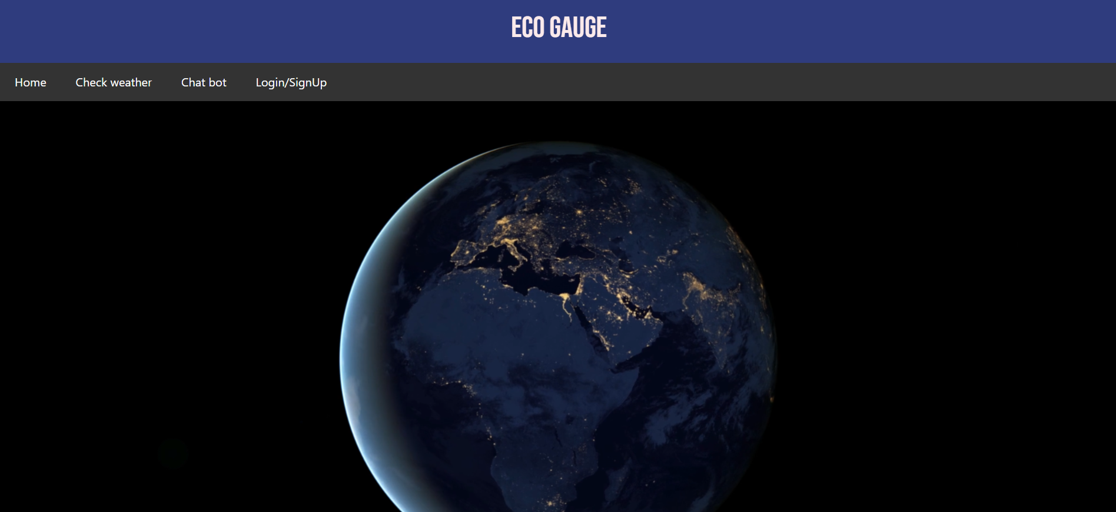
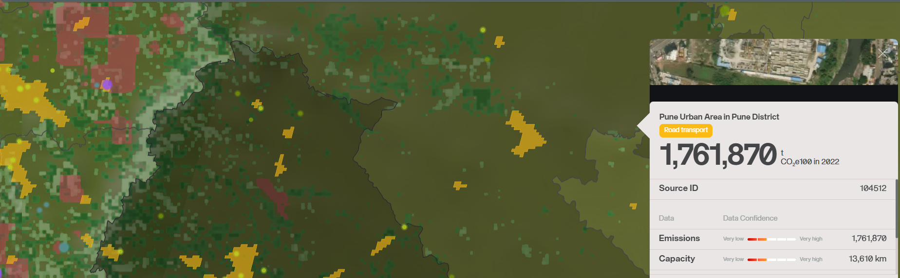
Project Snapshots
APP
GIS MAPPING

Slide 7


